Slide 1
Predictive Modelling on Clothing Reviews With Sentiment Analysis : Text Mining Approach
Miss. Prashali Shinde.
MBA-II (Business Analytics)

Slide 2
INTRODUCTION
Text Mining : (Text Data Mining)
Process analyzing large amounts of unstructured text data which will identify patterns, keywords and other attributes in the data.
Sentiment Analysis :
Categorizing opinions in order to determine whether the writer's attitude towards a particular topic, product is positive, negative, or neutral.
Text Mining and Sentiment Analysis both are part of Natural Language Processing(NLP)

Slide 3
ABOUT DATA
The Data is collected from Spice Clothing Store , Rajarampuri , which include clothing review of the women's visited the store with other relevant information variable.
The data has a collection of 22641 Rows and 10 column variables. Each row includes a written comment as well as additional customer information.
Variables in the Dataset are:
Clothing ID Review Text Rating
Age Title Recommended IND
Positive Feedback Count Division Name
Department Name Class Name

Slide 4
PROBLEM STATEMENT
Explore trends in the customer reviews from Spice’s women’s clothing data and extract actionable plans to improve their performance and take suitable actions on it.

Slide 5
OBJECTIVE OF THE STUDY
To understand customer appreciation and dislike about their purchases.
To know about most dominant sentiment from the feedback.
Use Naïve Bays classifier and Logistic Regression predictive model to predict recommendations from reviews.

Slide 6
RESEARCH METHODOLOGY
Analytical Platform:
Python Programming Language
Analytical Method :
Natural Language Processing Technique (Text Mining , Sentiment Analysis ) , Machine Learning Approach
Tokenization: Process of splitting text into Tokens
Tokens can be paragraph, sentences or single word
Stemming and Lemmatization: Also Called Word Normalization
Convert the word into its root form

Slide 7
Packages Used from Python For Programming
General Packages :
Scientific computation (numpy), dataframes (pandas), Natural Language Processing (NLTK).
Visualization Packages :
Creation of simple graphics (matplotlib, seaborn), text frequency visualization(wordcloud).
Pre-Processing section
Extracts modules from the NLTK package such as tokenizers and stemmers to enable the preparation of text data for mathematical analysis.
Modeling section
NLTK’s sentiment analysis module, which can determine the mood of text, NLTK’s N-grams, and gensim.models’s for frequency of N-grams. Sentiment Intensity analyzer for sentiment analysis

Slide 8
DATA ANALYSIS AND INTERPRETATION

Slide 9
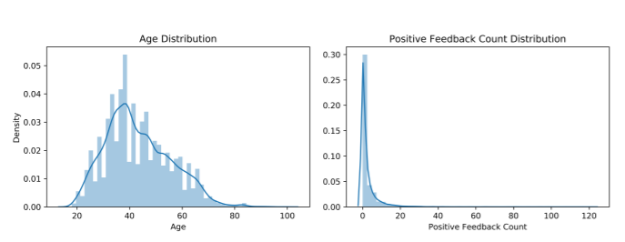
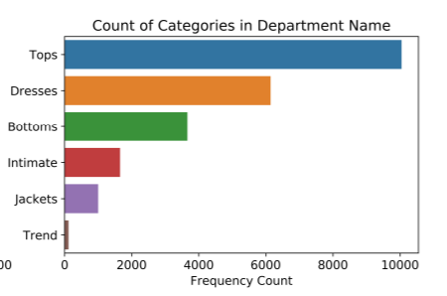
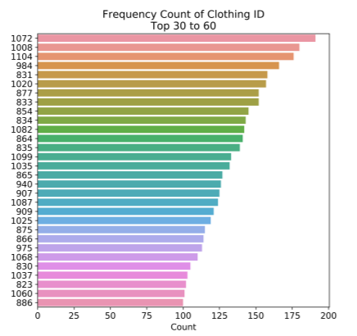
Statistical Analysis
Analysis Of Univariate Distributions:
Age group 35-44 mostly reviewed the product.
Tops are dominantly get reviewed.
Clothing id ‘s 1072, 1008 , 1104 general division of cloth is most reviewed.

Slide 10
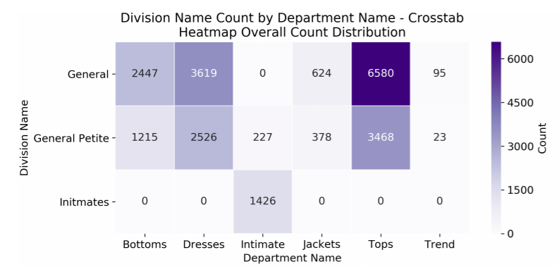
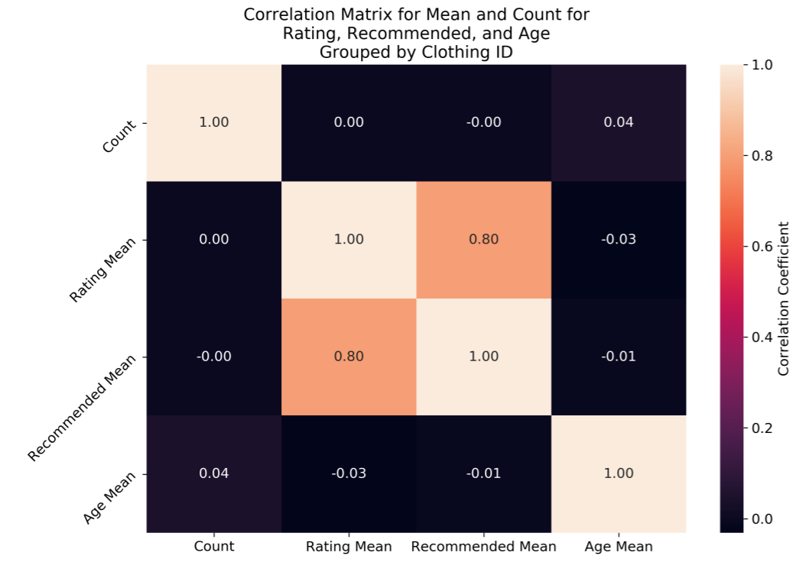
Analysis Of Multivariate Distributions and Descriptive Statistic
The above Heat map shows Dominance of General Tops
General Dresses are also getting more reviews
Correlation Matrix Suggest 0.80 strong correlation between Rating and Recommenadations.

Slide 11
Text Pre-processing
Text cleaning is done by eliminating delimiters such as \n and \r found in the texts.
NLTK package to lowercase, tokenize, and remove stop words and punctuation.
Implement the Porter Stemmer on the tokens to convert them to base form

Slide 12
Sentiment Analysis
The sentiment analyzer of NLTK was used to generate the sentiments.
Applying Model and Variable Creation classifies each review in the dataset on three dimensions: Positive, Neutral, and Negative. We get polarity score.
Based on the score we classify text as:
df.loc[df['Polarity Score']>0,'Sentiment']='Positive'
df.loc[df['Polarity Score']==0,'Sentiment']='Neutral'
df.loc[df['Polarity Score']<0,'Sentiment']='Negative’
A positive numbers closer to 1 indicates over positivity, and a negative number closer to -1 indicates over negativity.

Slide 13
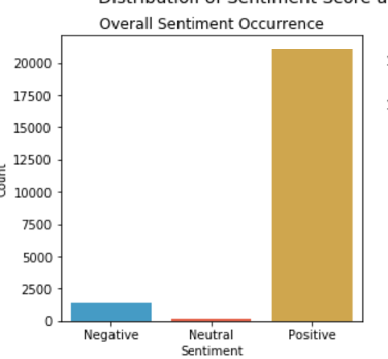
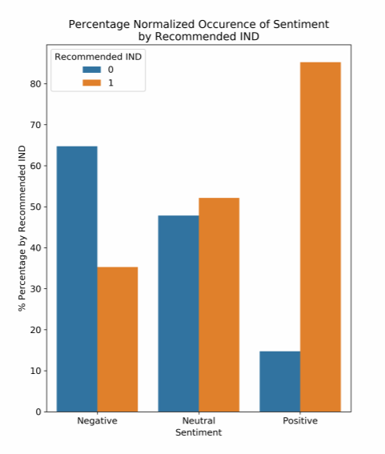
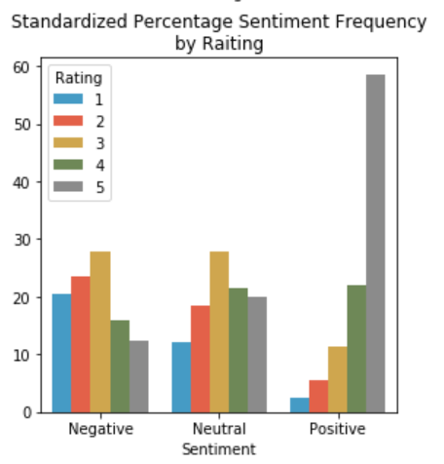
Exploring the sentiments
From total 22641 records 20000 are positive reviews , 1000 are neutral reviews and remain 1641 are Negative.
Positive sentiments are highly rated also but negative sentiments have more rating as 3 not 1.
Positive sentiments are highly recommended

Slide 14
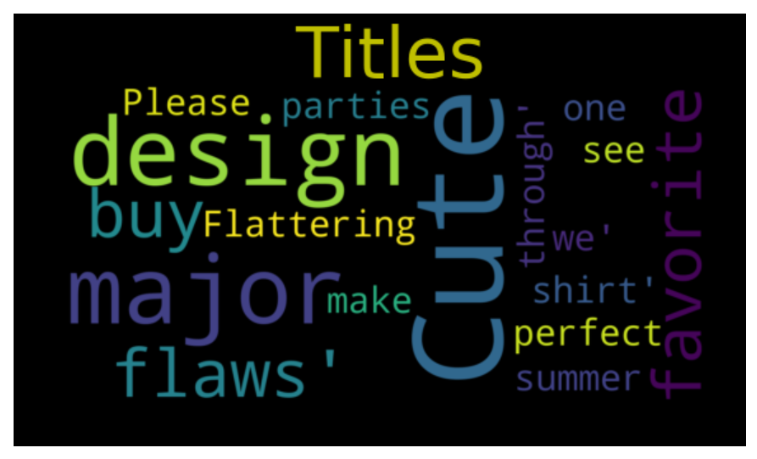
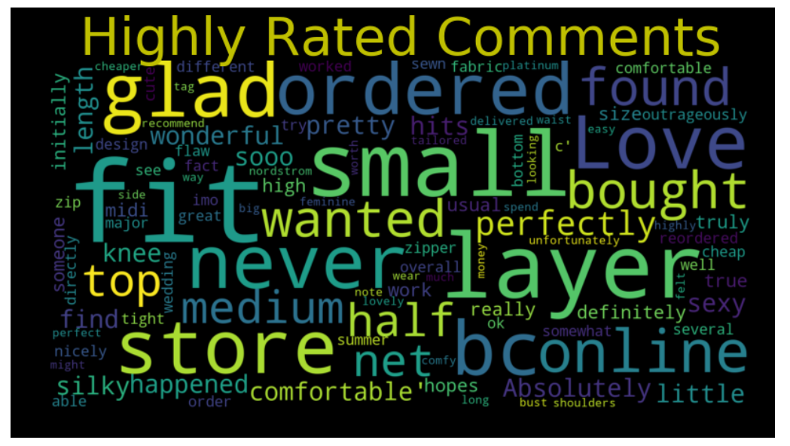
Wordcloud
Wordclouds are generated by using wordcloud package which gives frequency of occurrence of words and shows most dominant word

Slide 15
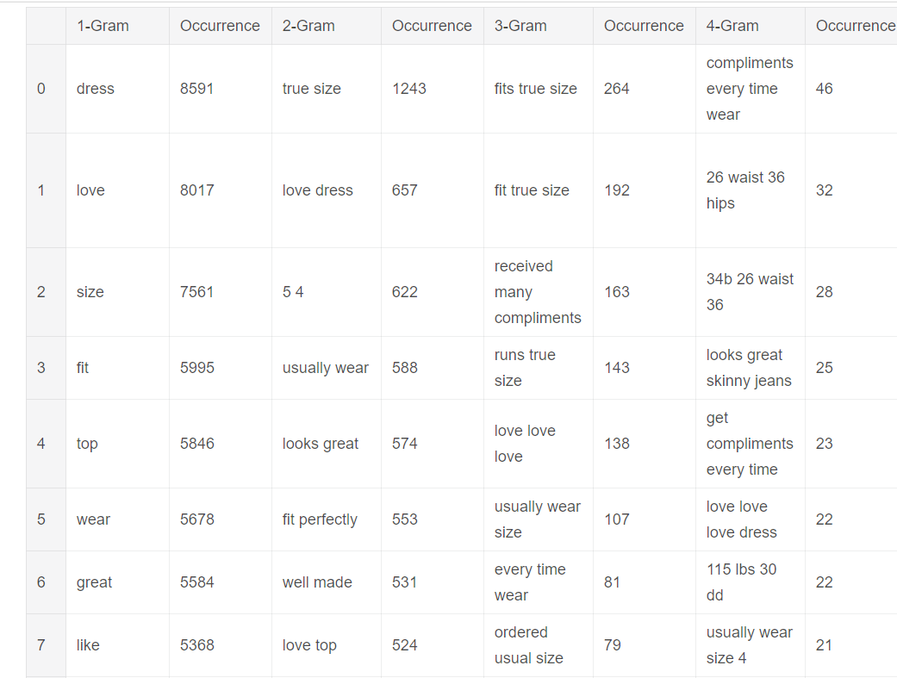
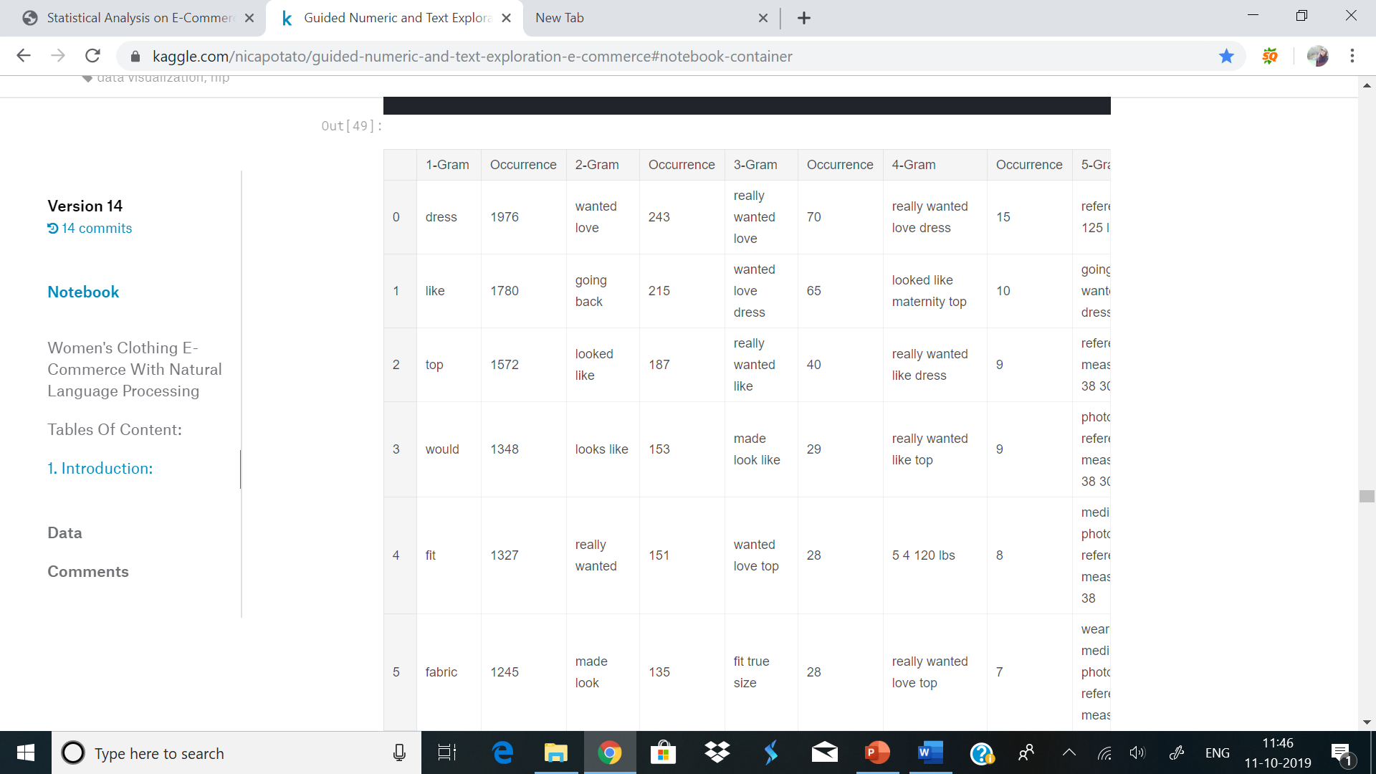
N-Grams
The N-grams gives the light on:
Recommended Items and Non Recommended Items:

Slide 16
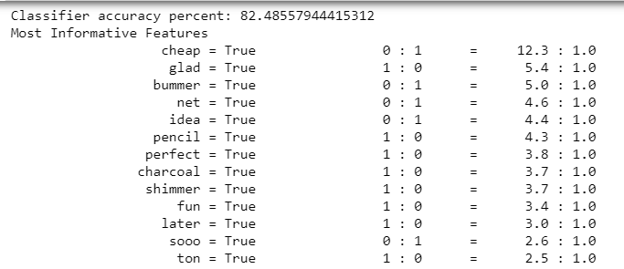
Predictive Modelling
For predicting recommendations based on review.
Independent Variable: Word choices in Reviews
Dependent Variable: Whether or not review was Recommended
Naïve Bays Classifier is used to train the model.
But the accuracy score for this is 82% which is low
1st Column -word 2nd displays – Recommendation (1:0)
Not Recommended(0:1)
Word Cheap – who's presence is 12.3 times more likely to be negative than positive

Slide 17
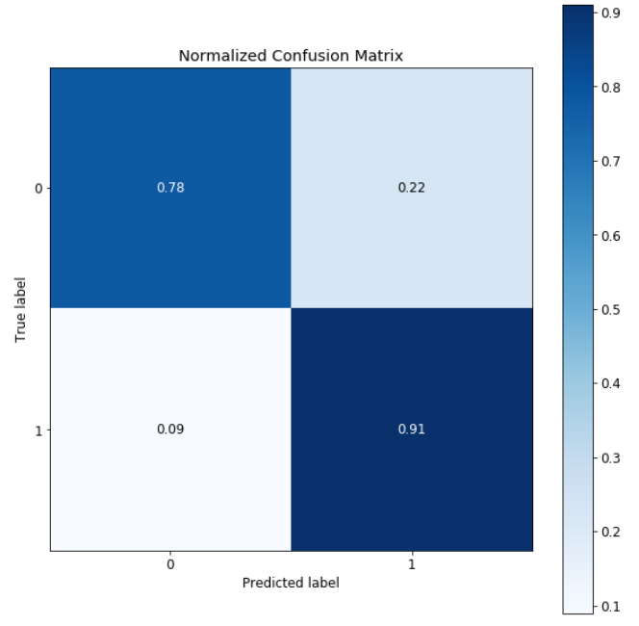
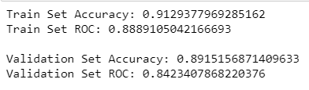
Confusion Matrix
Logistic Regression Gives Score of 91% which is good model for prediction.
The Confusion matrix shows that for non recommendations 0.78 predictions are true and 0.22 are wrong
For recommendations 0.91 predictions are correct and 0.09 are false.

Slide 18
INTERPRETATION AND RECOMMENDATIONS
From overall study we can interpret that reviews are highly affecting the recommendations and ratings for clothID.
As from previous statistic we saw that there are more recommendations for tops and dresses so that we can focus more on this to acquire more profit
From sentiment analysis we conclude that who's reviews are positive that cloth product is highly rated. Most Positive reviews can achieve by using result of wordcloud and N-grams.
For further study Recurrent Neural Network Algorithm can be used for prediction of sentiments from review.
Also the Age variable can be analysed against sentiments and reviews so that demographic analysis we can get.

Slide 19
REFERANCES
Statistical Analysis on E-Commerce Reviews, with Sentiment Classification using Bidirectional Recurrent Neural Network , by Abien Fred M. Agarap
https://www.linguamatics.com/what-text-mining-text-analytics-and-natural-language-processing
https://data-flair.training/blogs/text-mining/
https://www.kaggle.com/kerneler/starter-text-mining-e-commerce-2f915655-7

Slide 20
Thank You!!!

